Slide 1


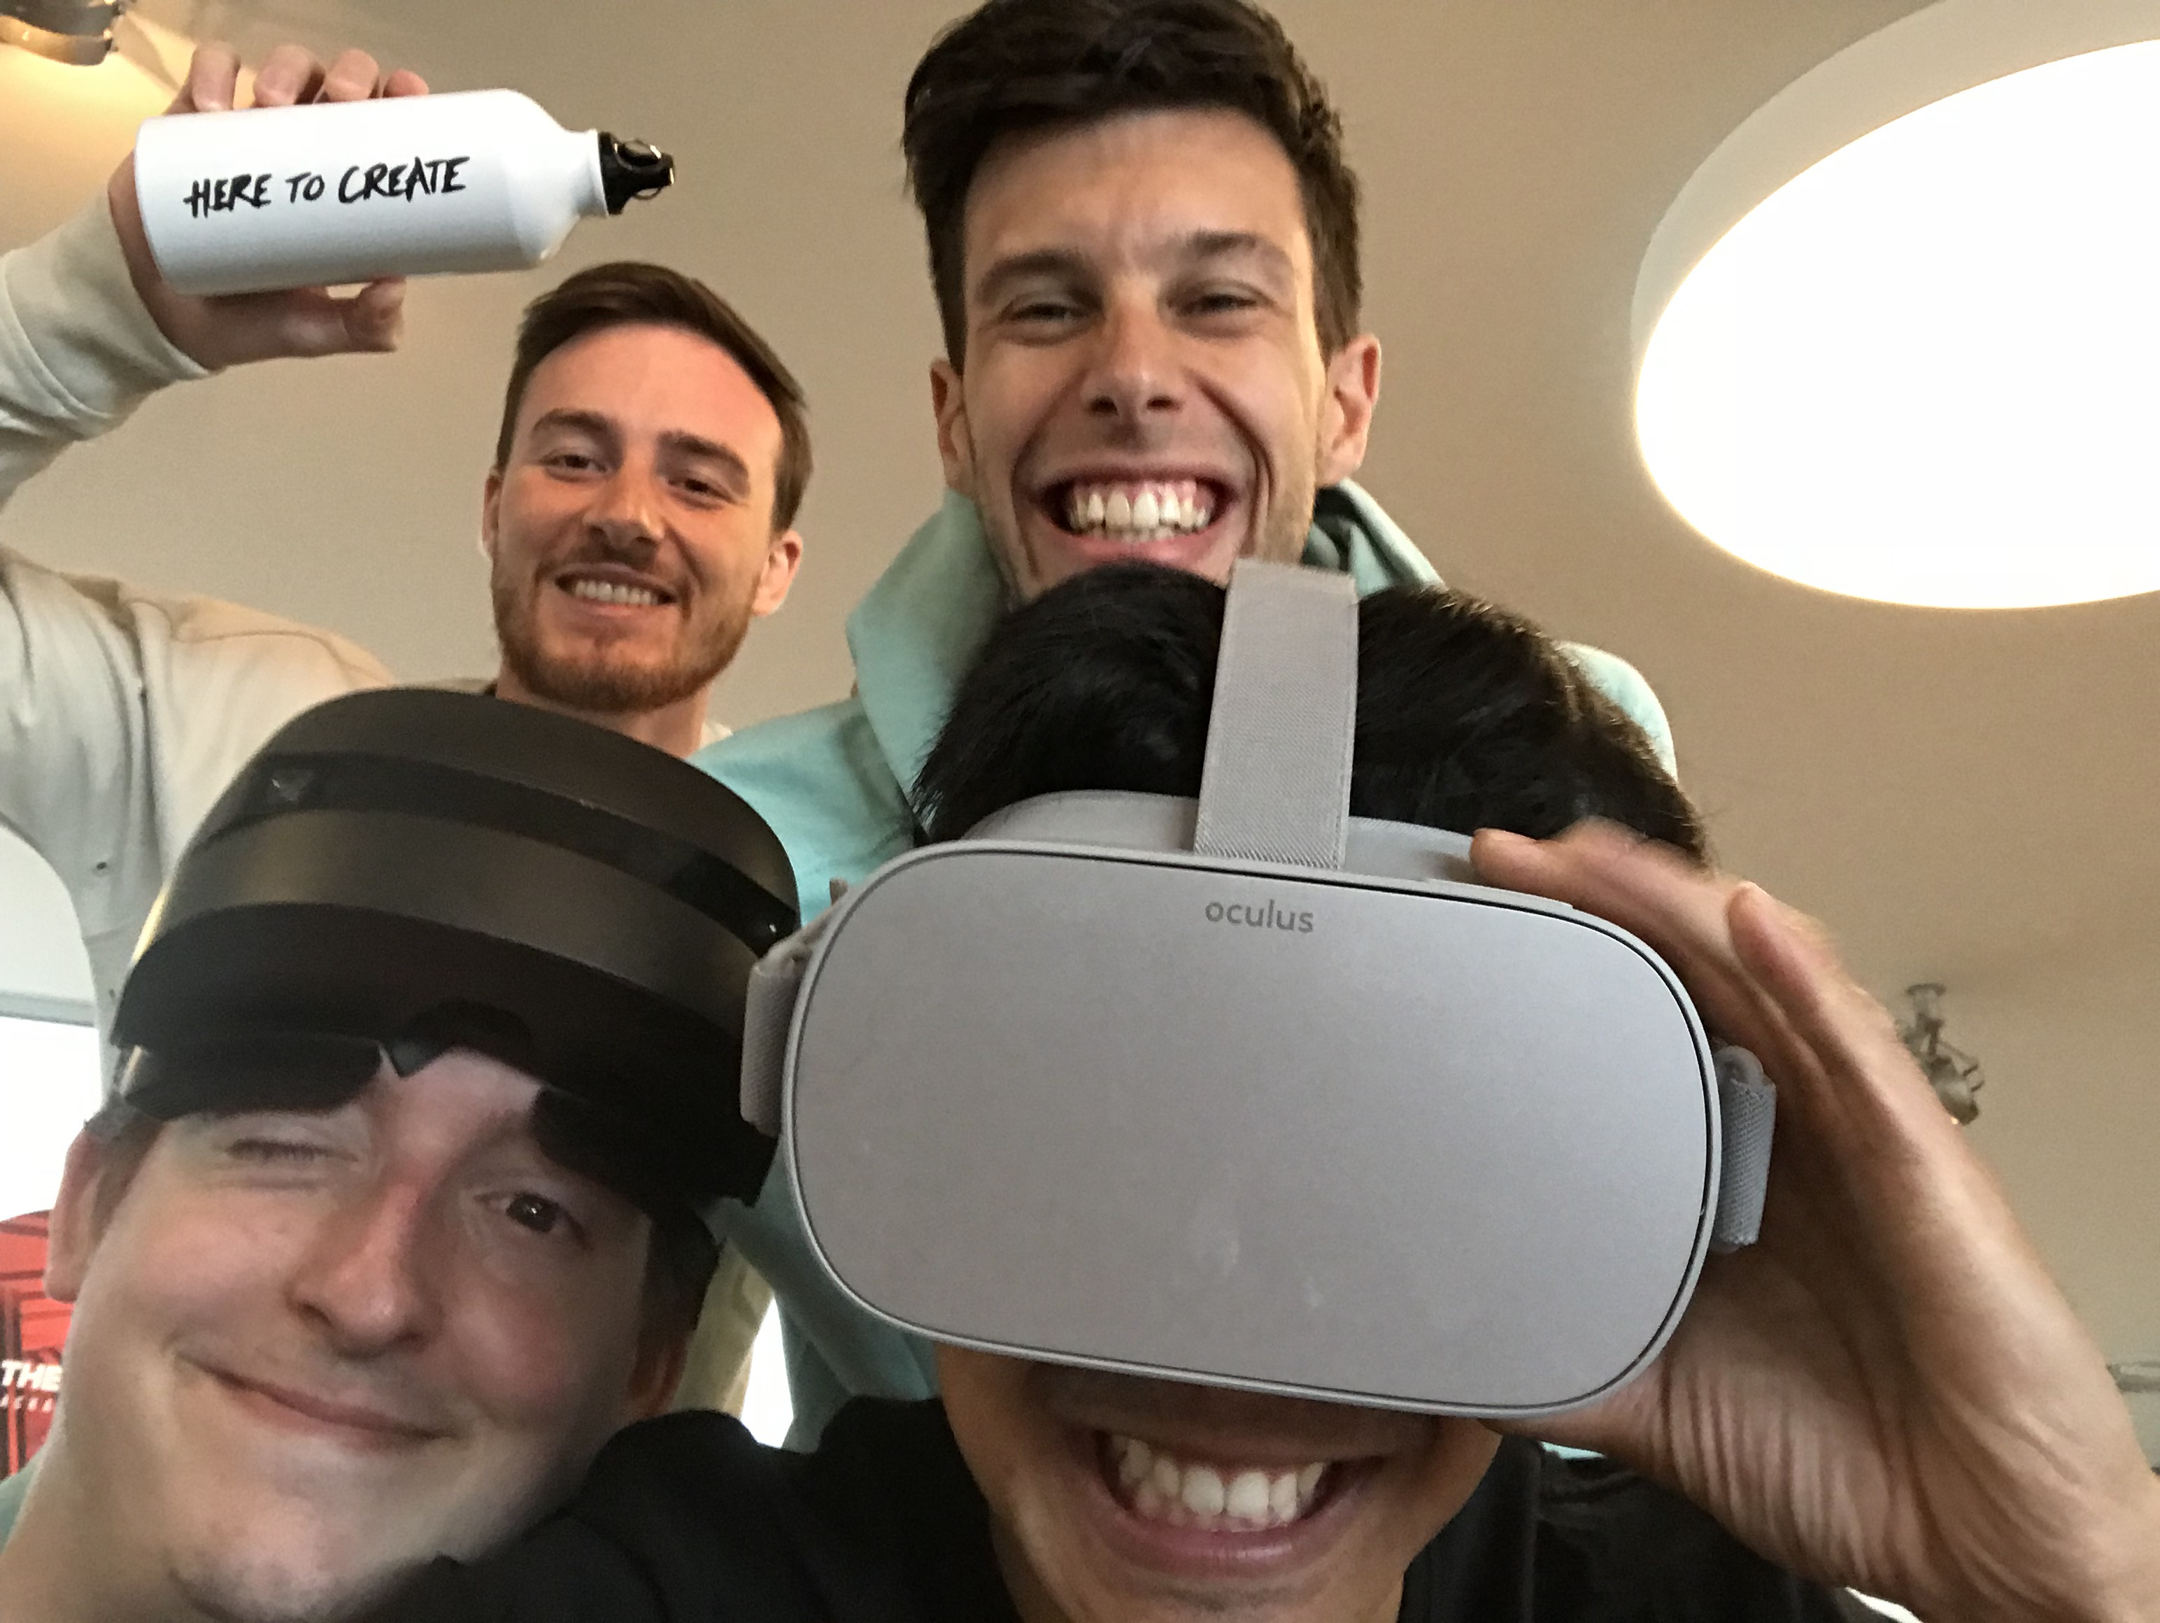


JUST-IN TIME
TEAM PICTURE
Eloi Stree
Justin Chin
Timo Menz
Maximilian Schmid
Real time interaction and analysis within immersive VR experiences
Oculus Go
360 Photography
TECHNOLOGIES
Mixed Reality
VR

